Slide 1




Slide 2




Slide 3




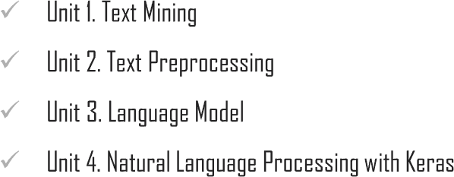
Chapter Description

Slide 4








Slide 5

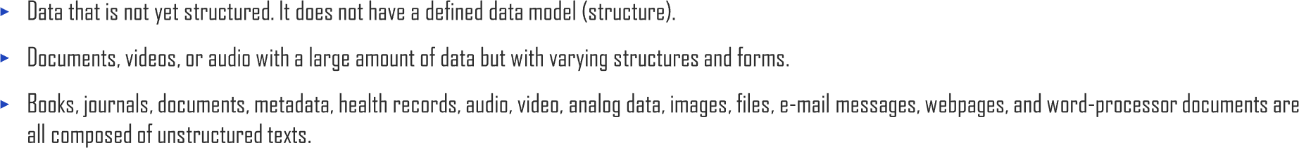

1.1. What is Text Mining?
UNIT 01
Unstructured Data
Video
Music
Message
Social Media
Location Info
Posts

Slide 6

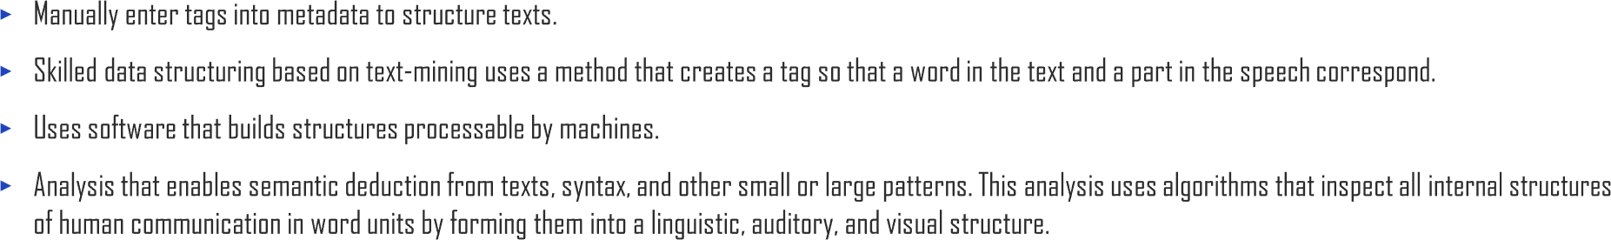
1.1. What is Text Mining?
UNIT 01
Finding pattern in unstructured data
Finding pattern in unstructured data
Use data mining, text analysis,
non-standard language analysis

Slide 7

1.1. What is Text Mining?
UNIT 01
Text Mining
Pattern
Extract & Preprocessing
Analysis & Evaluation
Data
Preprocessing Data
Knowledge

Slide 8

1.1. What is Text Mining?
UNIT 01

Slide 9
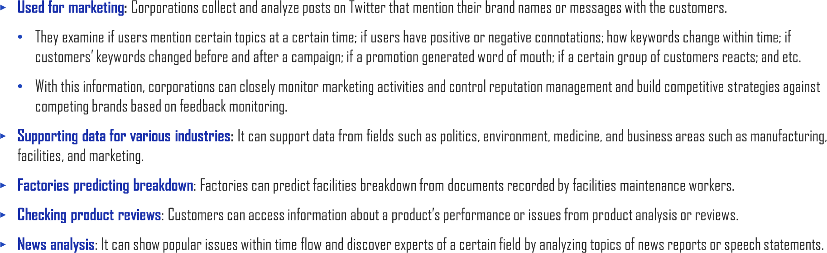
1.1. What is Text Mining?
UNIT 01

Slide 10
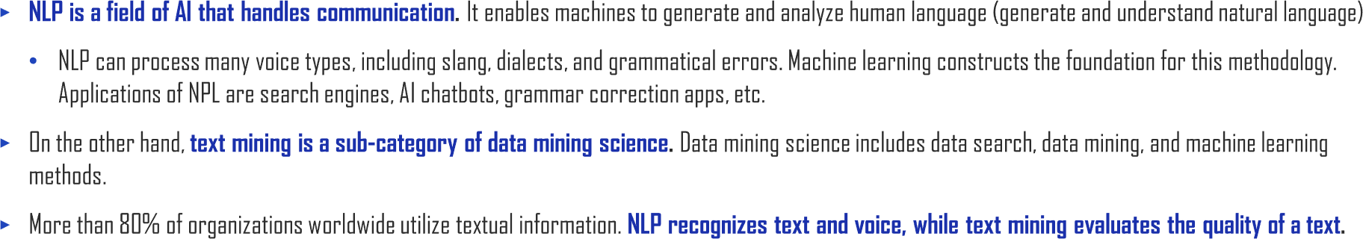
1.1. What is Text Mining?
UNIT 01

Slide 11
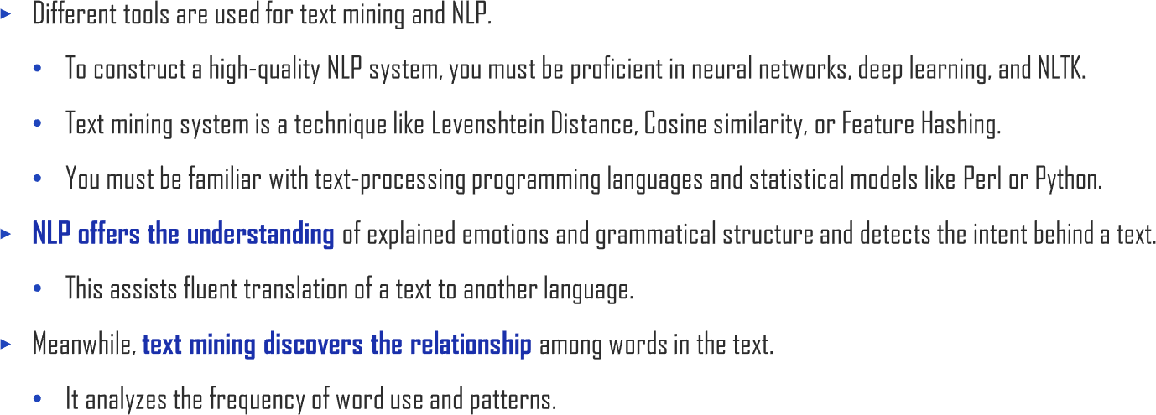
1.1. What is Text Mining?
UNIT 01

Slide 12
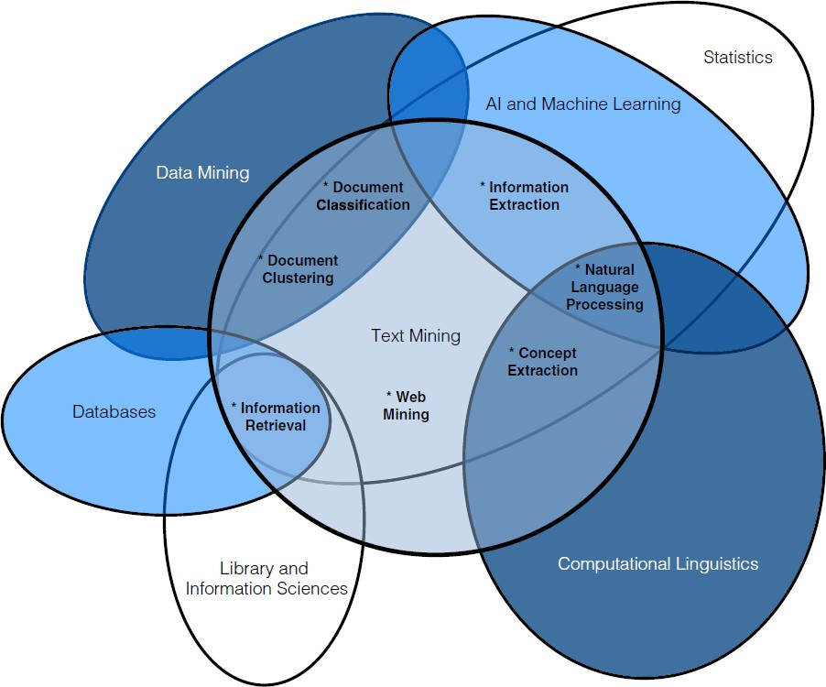
1.1. What is Text Mining?
UNIT 01
Statistics
AI and machine Learning
Data Mining
*Document Classification
*Document
Clustering
*Information
Extraction
*Natural Language Processing
Text Mining
*Concept
Databases
*Information Retrieval
*Web
Extraction
Mining
Library and
Computational Linguistics
Information Sciences

Slide 13
1.1. What is Text Mining?
UNIT 01
Algorithm | Area
Naïve bayes | Document classification
Conditional random fields | Information extraction
Hidden Markov models | Information extraction
K-means | Clustering
Singular value decomposition (SVD) | Document classification
Logistic regression | Document classification
Decision trees | Document classification
Topics | Practice Area
Keyword search | Search and information retrieval
Inverted index | Search and information retrieval
Document clustering | Document Clustering
Document similarity | Document Clustering
Feature selection | Document classification
Sentiment analysis | Document classification Web mining
Dimensionality reduction | Document classification
eDiscovery | Document classification

Slide 14
1.1. What is Text Mining?
UNIT 01
Algorithm | Area
Neural network | Document classification
Support vector machines | Document classification
MARSplines | Document classification
Link analysis | Concept extraction
k-nearest neighbors | Document classification
Word clustering | Concept extraction
Regression | classification
Topic | Practice Area
Web crawling | Web mining
Link analytics | Web mining
Entity extraction | Information extraction
Link extraction | Information extraction
Part of speech tagging | Natural language processing
Tokenization | Natural language processing
Question answering | Natural language processing Search and information retrieval
Topic modeling | Concept extraction
Synonym identification | Concept extraction

Slide 15
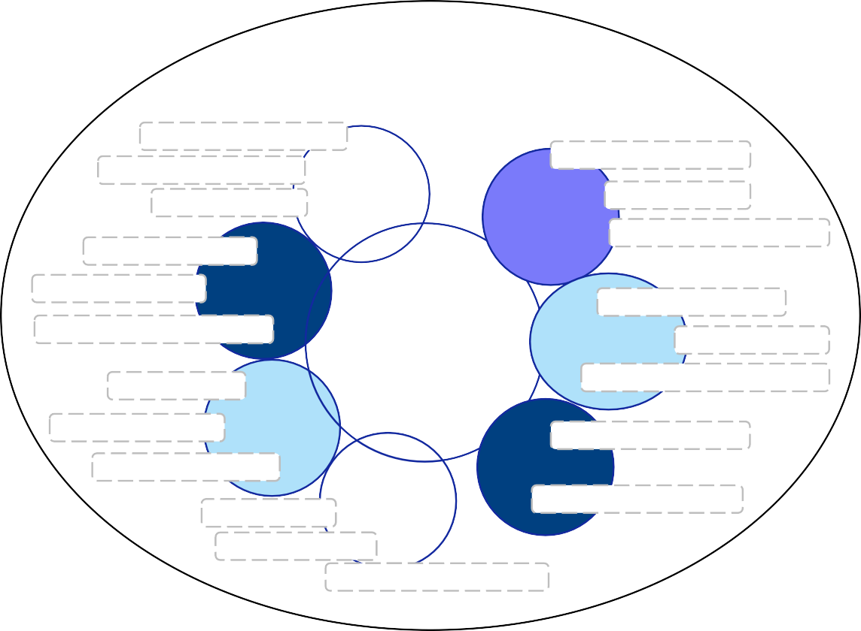
1.1. What is Text Mining?
UNIT 01
TEXT ANALYTICS
Document Matching
Search Optimization
Inverted Index
Web Content Mining
Information Retrieval
Web Analytics
Web Structure Analysis
Web Mining
Statistics
Machine Learning
Entity Extraction
Co-reference Relationship Extraction
Management Science
Information Extraction
Document Ranking
Text Mining
Classification
Alert Detection
Artificial Intelligence
Other Disciplines ^{Computer Science}
Colocations
Document Categorization
Word Association
Sentiment Analysis
Concept Extraction
Document Similarity
Natural Language Processing
Clustering
Document Clustering
Tokenization Lemmatization
Part-of-Speech Tagging

Slide 16
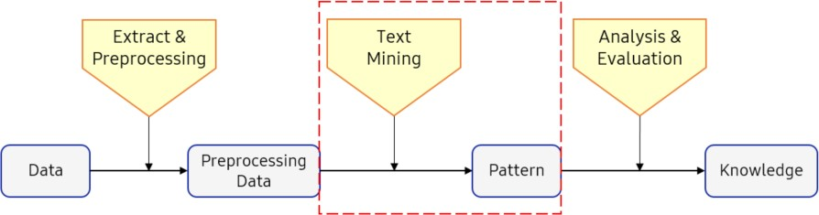



1.1. What is Text Mining?
UNIT 01
Document Collection
1
Establish the corpus: Collect and organize the domain-
specific data
Corpus
Feedback
2
Pre-process the data: Introduce structure to the corpus
Structured Data
2
Extract knowledge: Discover patterns from the preprocessed data
Patterns &
Associations
Feedback: adjustment / corrections
Feedback

Slide 17
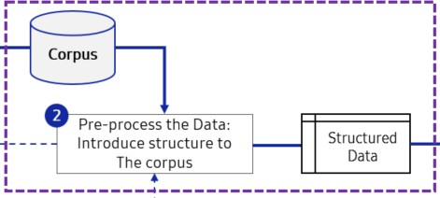




1.1. What is Text Mining?
UNIT 01
Corpus
1
Build stop, Include word list
Word-list
Feedback
2
Identify candidate terms
Term-list
Feedback
3
Create term-by- document matrix
TD Matrix
Feedback
4
Feedback
Simplify term-by- document matrix
Structured Data
Feedback

Slide 18


Slide 19
1.2. Data Collection
UNIT 01

Slide 20
1.2. Data Collection
UNIT 01
Technique | Features | Data Type
Crawling | Collects web documents and information on the web, such as social media, news, and web information. Follows URL link and repetitively collects. | Web document
Scraping | - Collects information from a single website (or document). | Web document
FTP | Transmits and receives files from internet servers using TCP/IP protocol. Considers using SFTP for reinforced security. Considers constructing an exclusive network for linked servers. | File
Open API | - Offers data collecting method with an open API that allows easy access to service, information, and data. | Real-time data
RSS | - XML-based content distribution protocol that allows sharing of up-to-date web-based information. | Content

Slide 21
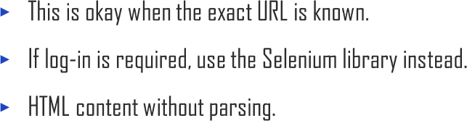

1.2. Data Collection
UNIT 01
Ex
Line 1-3
If the status code is 200, then OK.

Slide 22
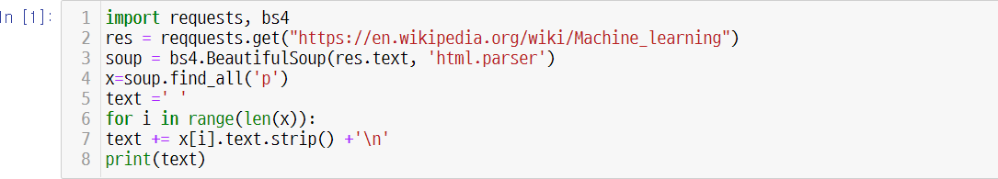
1.2. Data Collection
UNIT 01
Ex
Line 1-3
Return a BeautifulSoup object.

Slide 23

1.2. Data Collection
UNIT 01
Ex
Line 1-4
Get all the paragraphs.

Slide 24

1.2. Data Collection
UNIT 01
Ex
Line 1-7
Join all the text contents.

Slide 25
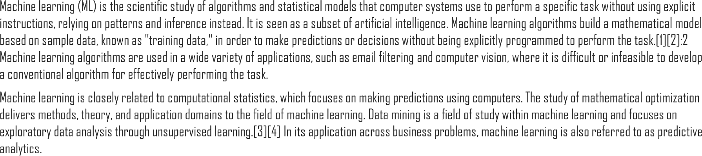
1.2. Data Collection
UNIT 01
Ex

Slide 26
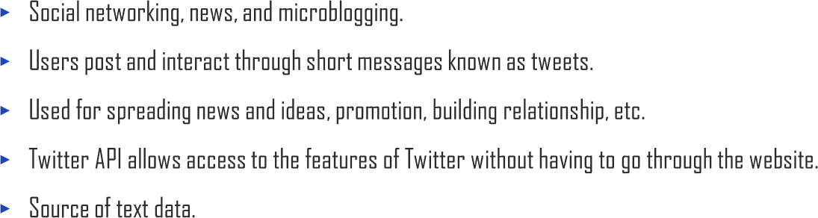

1.2. Data Collection
UNIT 01

Slide 27

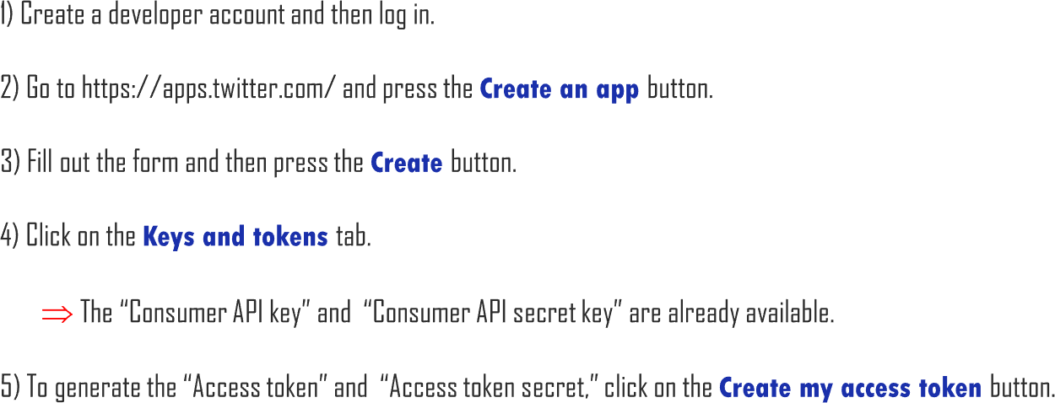
1.2. Data Collection
UNIT 01

Slide 28
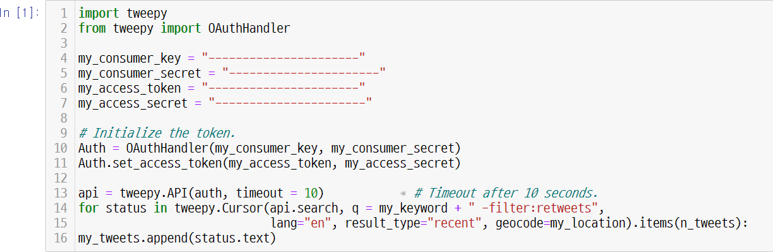
1.2. Data Collection
UNIT 01
Ex
Line 1-4 ~ 1-7
Replace with your own context.

Slide 29

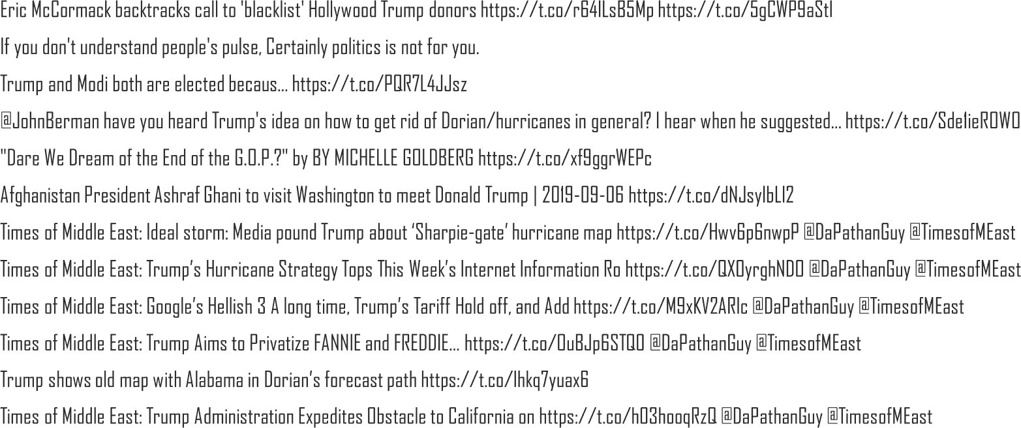
1.2. Data Collection
UNIT 01
Ex

Slide 30


Slide 31

1.3 String Manipulation
UNIT 01

Slide 32
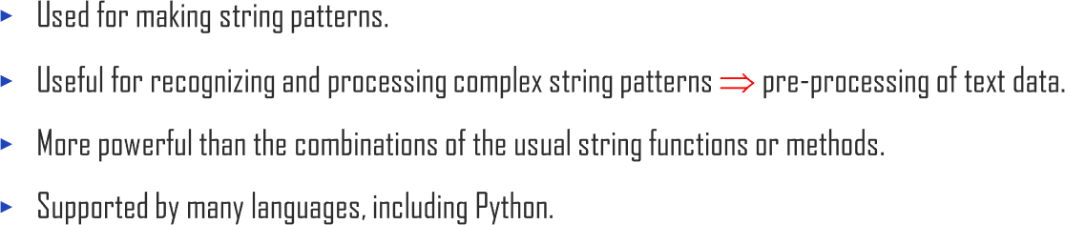
1.3 String Manipulation
UNIT 01

Slide 33

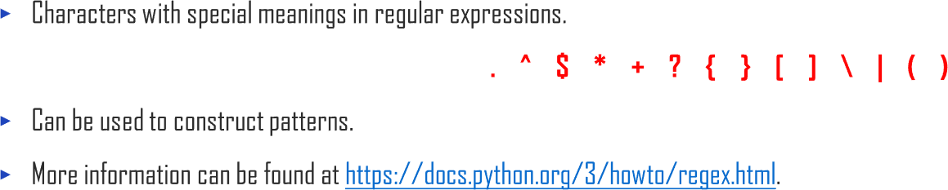
1.3 String Manipulation
UNIT 01

Slide 34

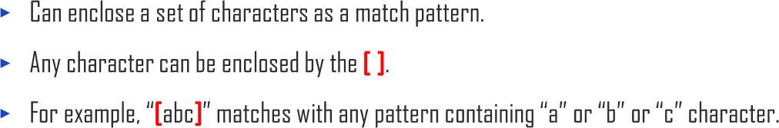
1.3 String Manipulation
UNIT 01

Slide 35
1.3 String Manipulation
UNIT 01
Ex
Ex
Ex Ex

Slide 36

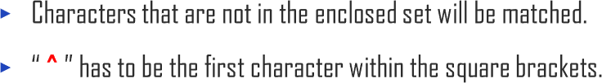
1.3 String Manipulation
UNIT 01

Slide 37

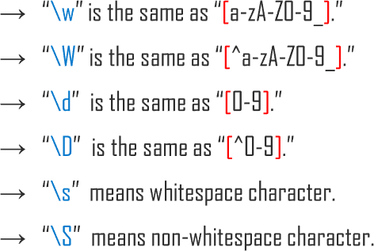
1.3 String Manipulation
UNIT 01

Slide 38

1.3 String Manipulation
UNIT 01

Slide 39
1.3 String Manipulation
UNIT 01

Slide 40
1.3 String Manipulation
UNIT 01

Slide 41
1.3 String Manipulation
UNIT 01

Slide 42

1.3 String Manipulation
UNIT 01

Slide 43

1.3 String Manipulation
UNIT 01

Slide 44
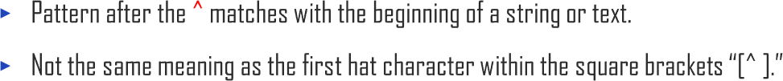
1.3 String Manipulation
UNIT 01

Slide 45

1.3 String Manipulation
UNIT 01

Slide 46

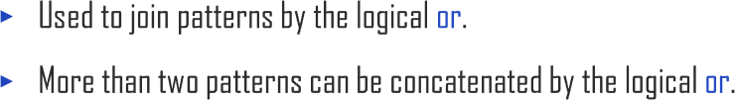
1.3 String Manipulation
UNIT 01

Slide 47

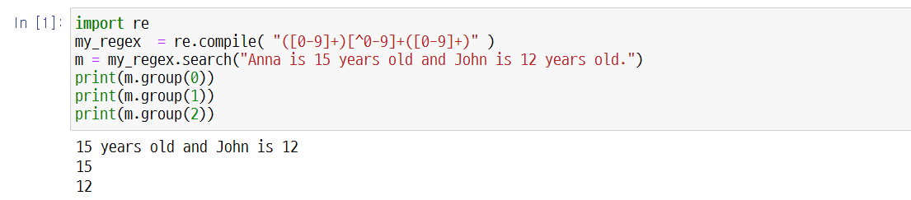
1.3 String Manipulation
UNIT 01
Ex

Slide 48

1.3 String Manipulation
UNIT 01
Ex
Line 1-3
If the status code is 200, then OK.

Slide 49
1.3 String Manipulation
UNIT 01
Ex
Line 1-4
Not easily intelligible yet.

Slide 50
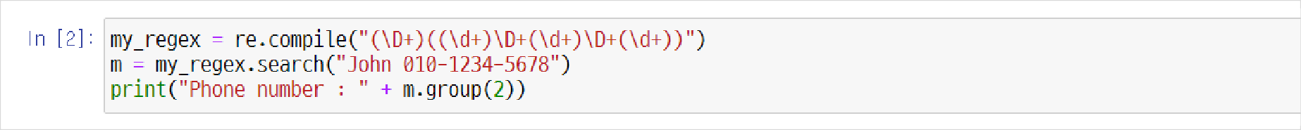
1.3 String Manipulation
UNIT 01
Ex

Slide 52
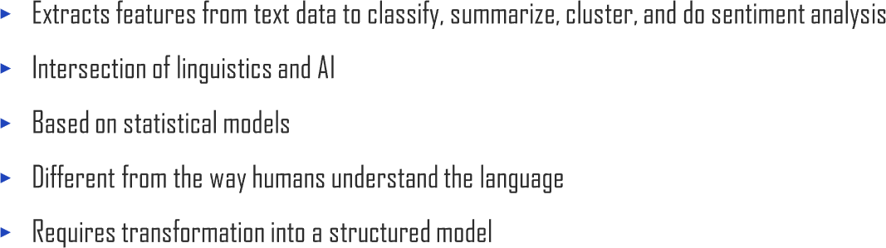
1.4. Natural Language Processing (NLP)
UNIT 01

Slide 53
1.4. Natural Language Processing (NLP)
UNIT 01
language language
computer
understanding (NLU)
generation (NLG)

Slide 54






1.4. Natural Language Processing (NLP)
UNIT 01

Slide 55
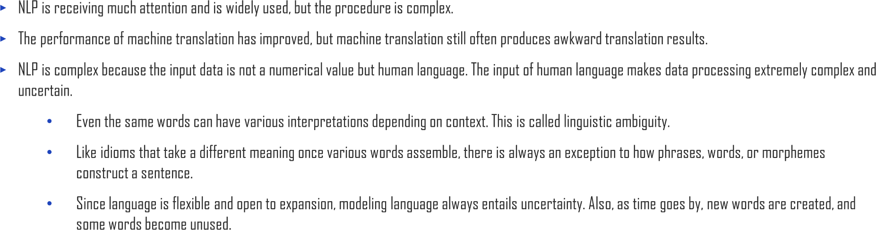
1.4. Natural Language Processing (NLP)
UNIT 01

Slide 56
1.4. Natural Language Processing (NLP)
UNIT 01
It decides the part of speech (POS) for a given word based on linguistic phenomena rather than statistical methods.
In the sentence below, it grasps the meaning of the sentence with the first verb and figures out the object of the instruction and its subject matter with ‘to’ or ‘that.’
“Send a message to Michael that I will be late for the meeting.”

Slide 57
1.4. Natural Language Processing (NLP)
UNIT 01
Lexical probability is a probability that a certain POS applies to a word. This can be expressed as P (POS | word) in mathematical form.
Contextual possibility is a possibility that a certain POS of a word will show with the POS of the next word. Mathematically, this is P (POS | POS).
Then, it labels the POS that produces the highest result of the multiplication of linguistic probability and contextual probability as the most appropriate for words of semantic ambiguity.

Slide 58
1.4. Natural Language Processing (NLP)
UNIT 01
NLP models that understand a sentence or the overall context of sentences could have been created after deep learning-based NLP was initiated.
If you create an artificial neural network component that connects with all parts of a sentence, this variable, after learning, contains information about the whole sentence. The accuracy is constantly increasing.

Slide 59

1.4. Natural Language Processing (NLP)
UNIT 01

Slide 60


Slide 61

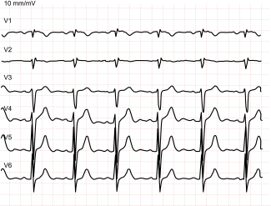

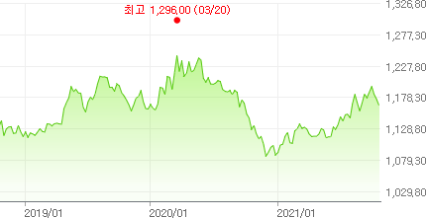
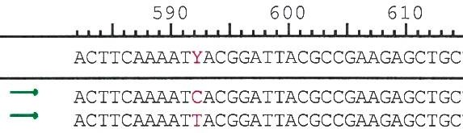
1.5. Sequential Data
UNIT 01
(a) ECG signal (b) Stock price
(c) Vocal signal
Climbing down did I see, the flower I couldn’t see on the way up
(d) sentence
(e) DNA sequence

Slide 62
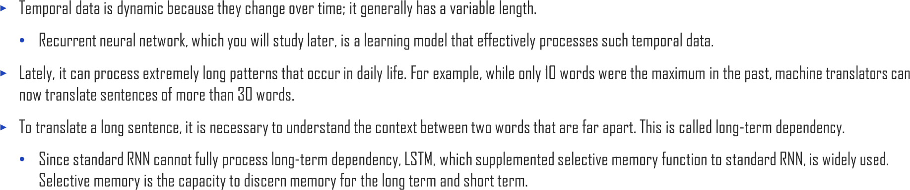
1.5. Sequential Data
UNIT 01

Slide 63


Slide 64


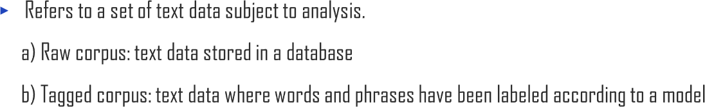
1.6. Corpus
UNIT 01

Slide 65









Slide 66


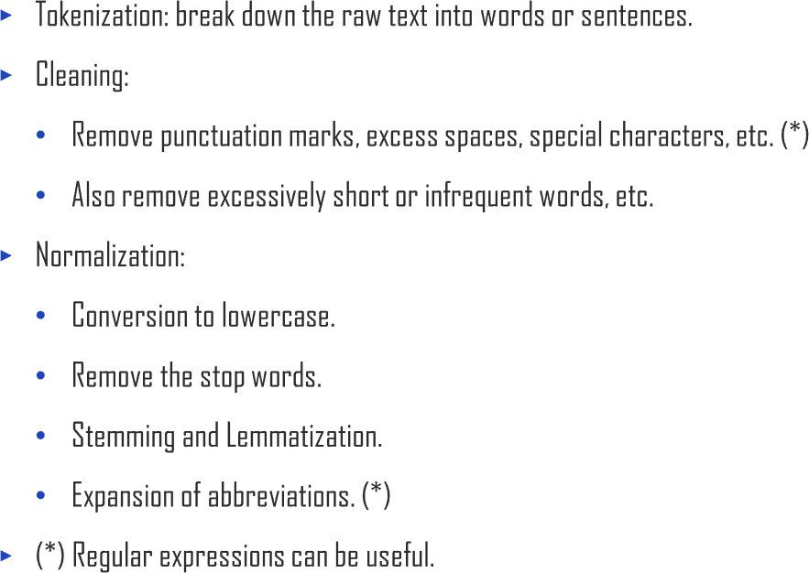
2.1. Tokenization
UNIT 02

Slide 67

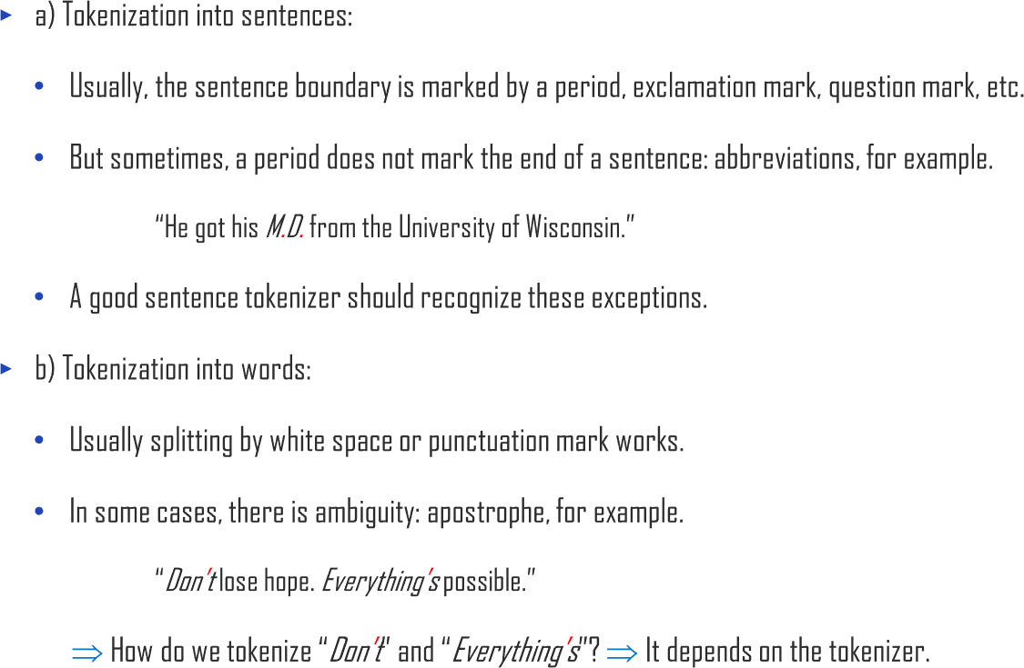
2.1. Tokenization
UNIT 02
Ex
Ex

Slide 68
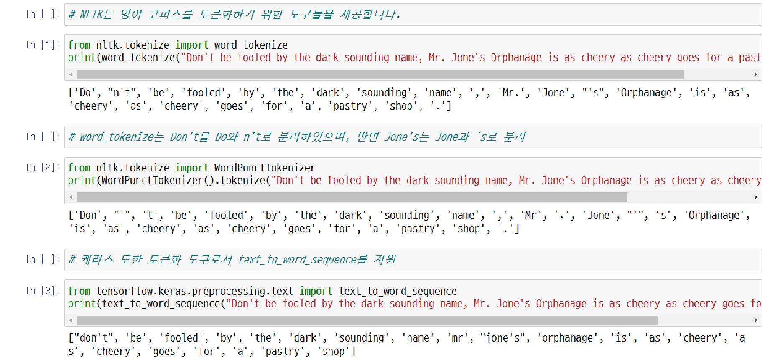
2.1. Tokenization
UNIT 02
# NLTK offers tools necessary for tokenization of English corpus.
# word_tokenize separated Don’t into Do and n’t, but Jone’s into Jone and ‘s
# Keras, also as a tokenization tool, supports text_to_word_sequence

Slide 69



Slide 70


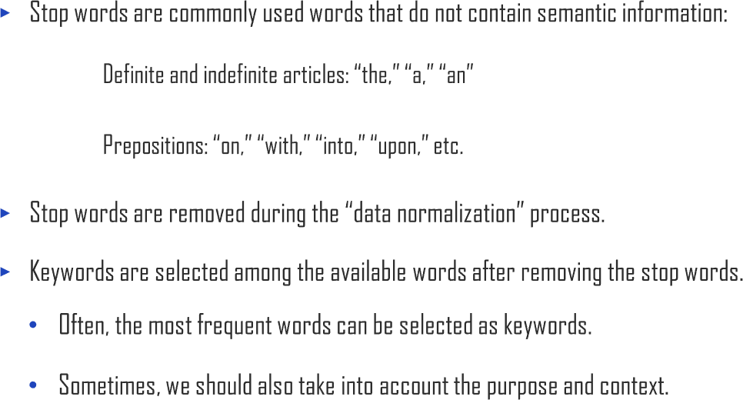
2.2. Stop Words
UNIT 02
Ex
Ex

Slide 71

2.2. Stop Words
UNIT 02
i, me, my, myself, we, our, ours, ourselves, you, you're, you've, you'll, you'd, your, yours, yourself, yourselves, he, him, his, himself, she, she's, her, hers, herself, it, it's, its, itself, they, them, their, theirs, themselves, what, which, who, whom, this, that, that'll, these, those, am, is, are, was, w ere, be, been, being, have, has, had, having, do, does, did, doing, a, an, the, and, but, if, or, because, as, until, while, of, at, by, for, with, about, against, between, into, through, during, before, after, above, below, to, from, up, down, in, out, on, off, over, under, again, further, then, once, here, there, when, where, why, how, all, any, both, each, few, more, most, other, some, such, no, nor, not, only, own, same, so, than, too, very, s, t, can, will, just, don, don't, should, should've, now, d, ll, m, o, re, ve, y, ain, aren, aren't, couldn, couldn't, didn, didn't, doesn, doesn't, hadn, hadn't, hasn, hasn't, haven, haven't, isn, isn't, ma, mightn, mightn't, mustn, mustn't, needn, needn't, shan, shan't, shouldn, shouldn't, wasn, wasn't, weren, weren't, won, won't, wouldn, wouldn't

Slide 72
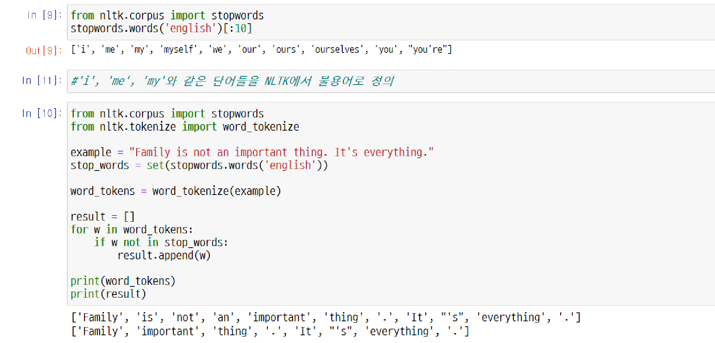
2.2. Stop Words
UNIT 02
# NLTK defines words such as 'i', 'me', 'my' as stop words

Slide 74
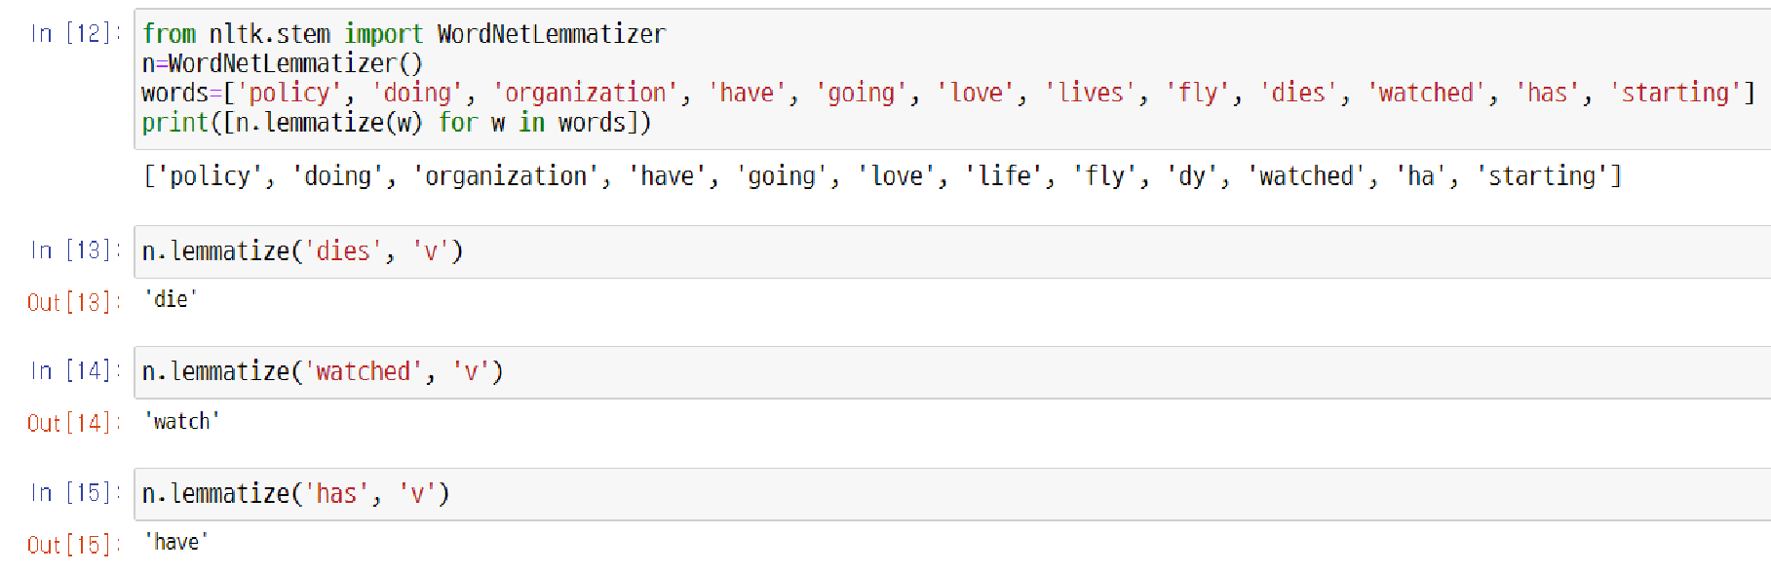
2.3. Lemmatization and Stemming
UNIT 02

Slide 75

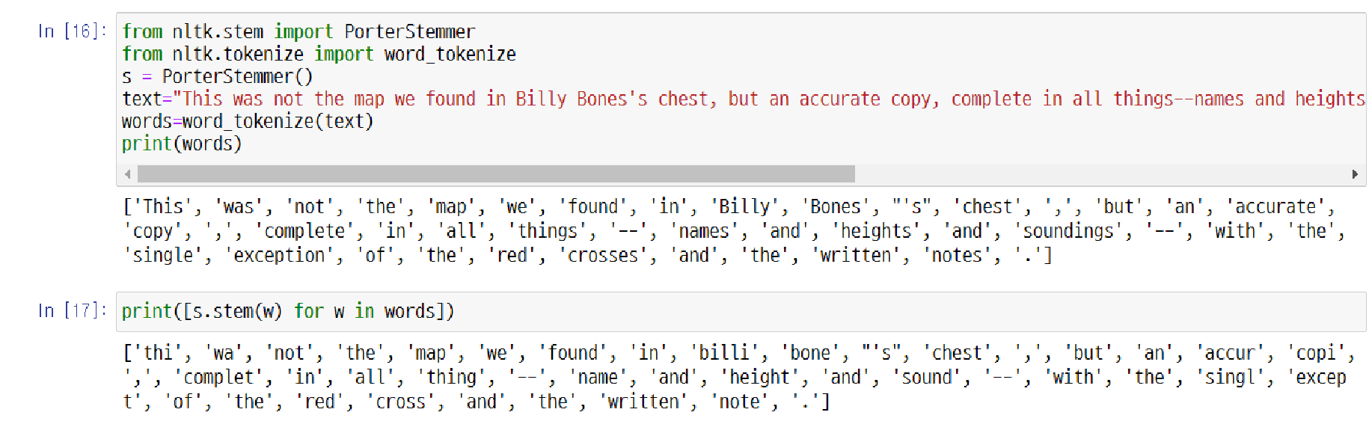
2.3. Lemmatization and Stemming
UNIT 02

Slide 76
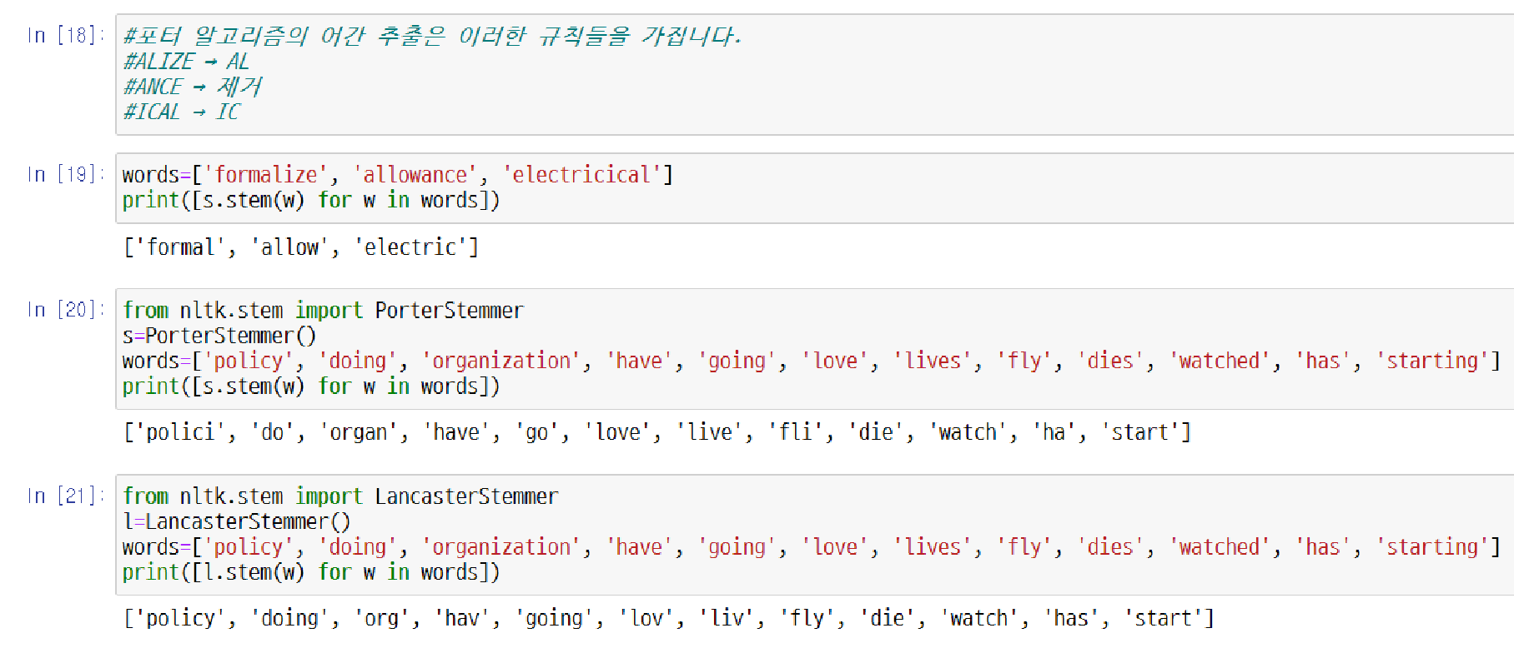
2.3. Lemmatization and Stemming
UNIT 02
#Stemmization of porter algorithm has rules as below.
Delete

Slide 77


Slide 78

2.4. POS Tagging
UNIT 02
Tag Set | Description | Example

Slide 79
2.4. POS Tagging
UNIT 02
Tag Set | Description | Example

Slide 80
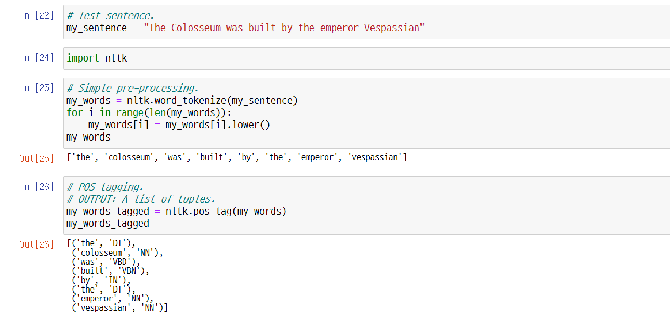
2.4. POS Tagging
UNIT 02

Slide 81

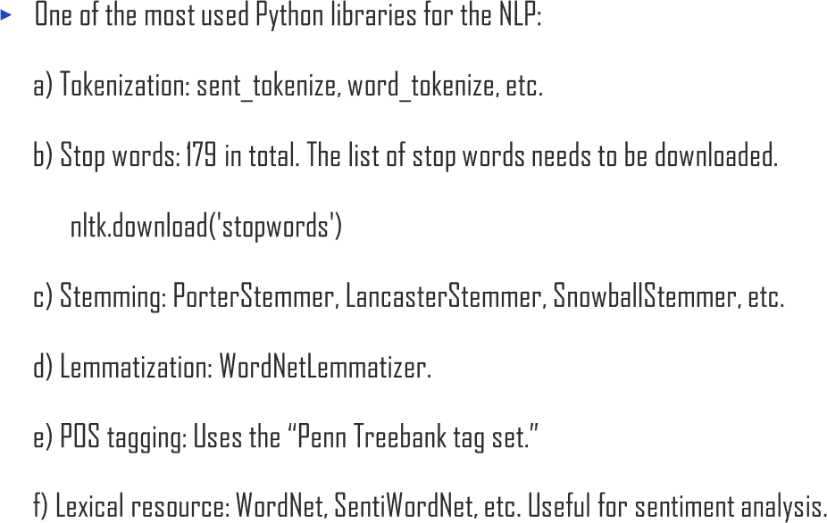
2.4. POS Tagging
UNIT 02

Slide 82

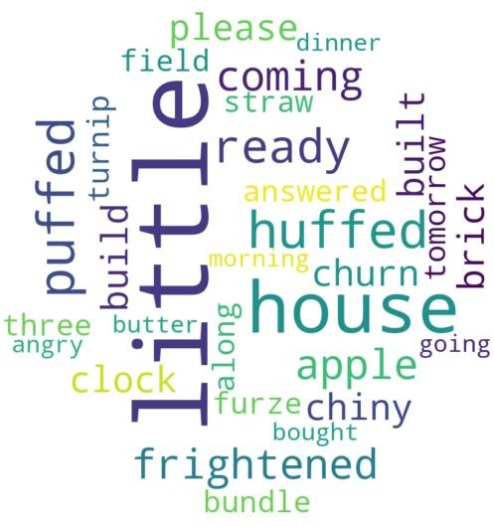
2.4. POS Tagging
UNIT 02

Slide 83
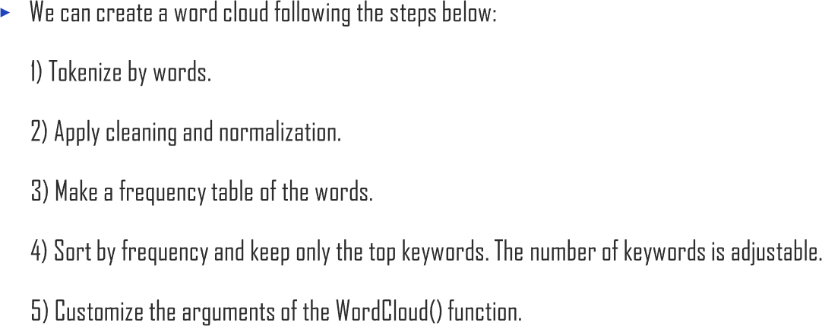
2.4. POS Tagging
UNIT 02

Slide 84


Slide 85

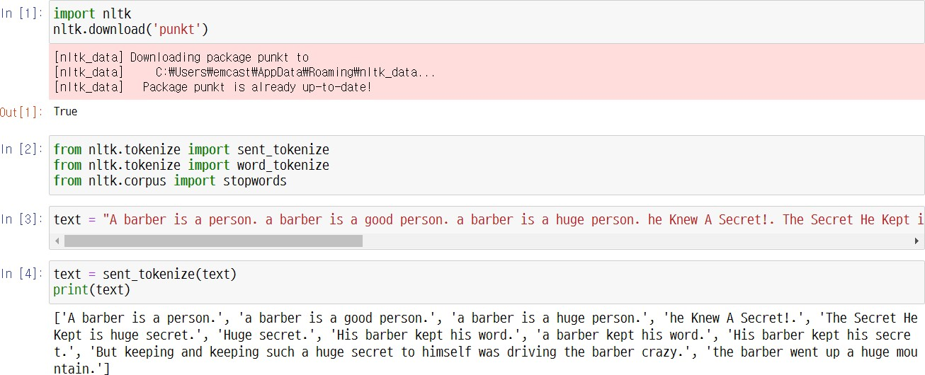
2.5. Integer Encoding
UNIT 02

Slide 86

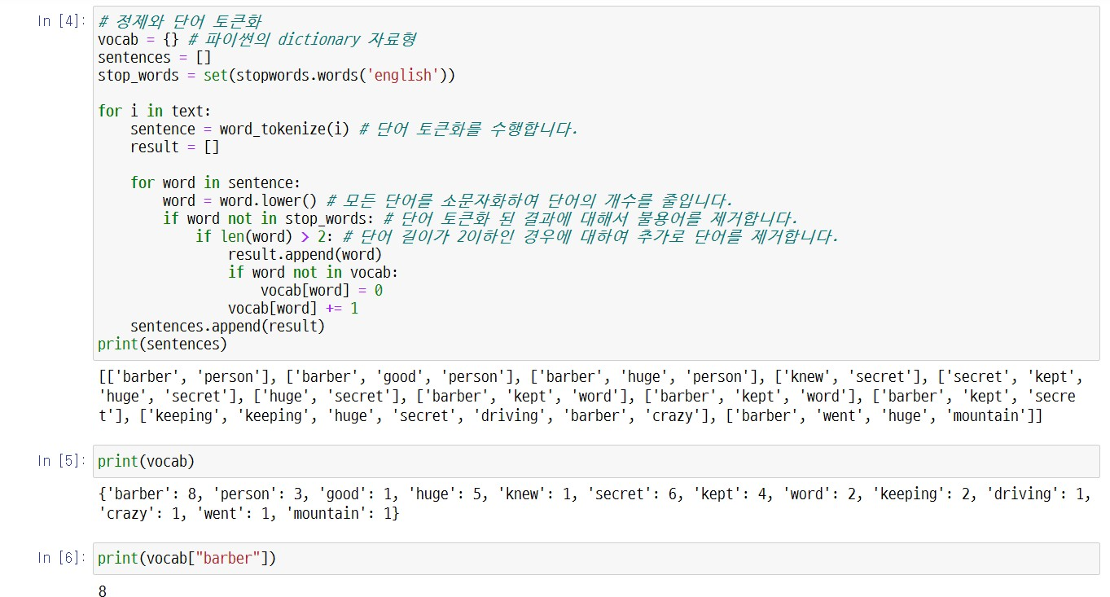
2.5. Integer Encoding
UNIT 02
# Cleaning and word tokenization
# Python’s dictionary datatype
# executes word tokenization
# Reduce the number of words by lowercasing all words
# Remove stop words in case of word tokenization.
# Remove additional words if the length of the word is lower or equal to 2

Slide 87
2.5. Integer Encoding
UNIT 02

Slide 88
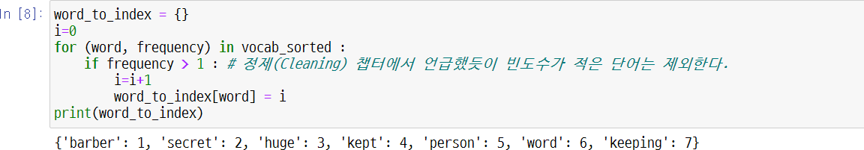
2.5. Integer Encoding
UNIT 02
# Low frequency words are deleted. (It was learned in the Cleaning section.)

Slide 89

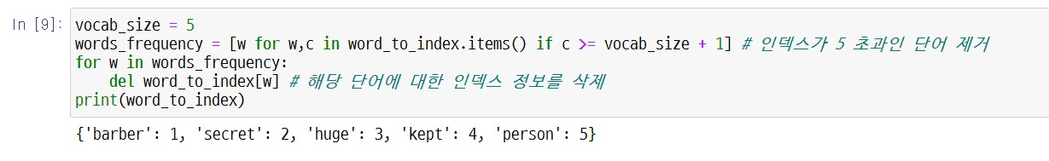
2.5. Integer Encoding
UNIT 02
# Remove words of index higher than
# Remove index information from the corresponding word
5

Slide 90
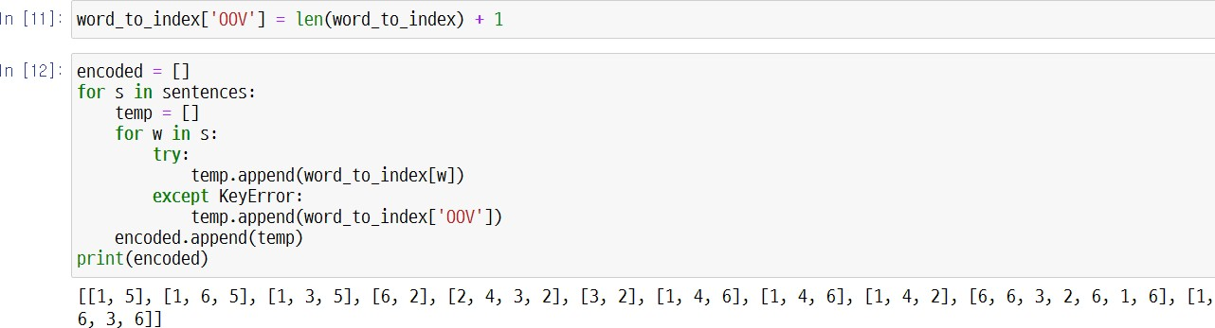
2.5. Integer Encoding
UNIT 02

Slide 91


2.5. Integer Encoding
UNIT 02
# Above task can be executed by words=np.hstack(sentences)
# You can easily count all frequency of the words by using Python’s Counter module.
# Print the frequency of the word ‘barber’

Slide 92

2.5. Integer Encoding
UNIT 02
# Save top 5 words with the highest frequency

Slide 93


2.5. Integer Encoding
UNIT 02
# Remove sentence section with np.hstack and use it as input. Ex) 'barber', 'person', 'barber', 'good
# Save top 5 words with the highest frequency

Slide 94


2.5. Integer Encoding
UNIT 02
of input
# Assign index starting from 0 in the order

Slide 95


2.5. Integer Encoding
UNIT 02
# fit_on_texts(), with corpus as input, generates vocabulary based on word frequency

Slide 96


2.5. Integer Encoding
UNIT 02

Slide 97


Slide 98



2.6. Padding
UNIT 02
# fit_on_texts(), with corpus as input, generates vocabulary based on
word freq

Slide 99


2.6. Padding
UNIT 02
# For each sentence
# If smaller than max_len

Slide 100

2.6. Padding
UNIT 02

Slide 101

2.6. Padding
UNIT 02

Slide 102


Slide 103


2.7. One-hot Encoding
UNIT 02
word
# Print encoding result for each

Slide 104

2.7. One-hot Encoding
UNIT 02

Slide 105
2.7. One-hot Encoding
UNIT 02

Slide 106







Slide 107

3.1. Language Model
UNIT 03

Slide 108


3.1. Language Model
UNIT 03

Slide 109


3.1. Language Model
UNIT 03
Ex

Slide 110



3.1. Language Model
UNIT 03
Ex

Slide 111

3.1. Language Model
UNIT 03
Ex

Slide 112



3.1. Language Model
UNIT 03

Slide 113
3.1. Language Model
UNIT 03
Ex

Slide 114


3.1. Language Model
UNIT 03

Slide 115


Slide 116









3.2. Representation Model
UNIT 03
Ex

Slide 117
3.2. Representation Model
UNIT 03
Ex

Slide 118

3.2. Representation Model
UNIT 03

Slide 119

3.2. Representation Model
UNIT 03
Ex

Slide 120
3.2. Representation Model
UNIT 03
Ex

Slide 121


3.2. Representation Model
UNIT 03

Slide 122


3.2. Representation Model
UNIT 03
Ex

Slide 123

3.2. Representation Model
UNIT 03

Slide 124
3.2. Representation Model
UNIT 03
Ex

Slide 125

3.2. Representation Model
UNIT 03
Ex
×
=

Slide 126


3.2. Representation Model
UNIT 03
∙
𝑋₂
θ
∙
𝑋₁

Slide 127


3.2. Representation Model
UNIT 03

Slide 129



3.3. Classification Analysis
UNIT 03

Slide 130



3.3. Classification Analysis
UNIT 03

Slide 131

3.3. Classification Analysis
UNIT 03

Slide 132


3.3. Classification Analysis
UNIT 03
A
𝑤
B
𝑤
𝑤
4
𝑤_{1 𝑤}
𝑤
1
𝑤₂
2
𝑤₃
𝑤₂
5
1
𝑤
2
𝑤₁
𝑤₂
𝑤₆ ^{𝑤}3

Slide 133


3.3. Classification Analysis
UNIT 03

Slide 134




3.3. Classification Analysis
UNIT 03
 | 𝑋₁ | 𝑋₂ | 𝑋₃ | ⋯ | 𝑌
Obs. #1
Obs. #2
Obs. #3
⋮
 | 𝑊₁ | 𝑊₂ | 𝑊₃ | ⋯ | 𝑌
Doc. #1
Doc. #2
Doc. #3
⋮

Slide 135

3.3. Classification Analysis
UNIT 03

Slide 136


Slide 137

3.4. Topic Modeling
UNIT 03

Slide 138

3.4. Topic Modeling
UNIT 03

Slide 139

3.4. Topic Modeling
UNIT 03

Slide 140
3.4. Topic Modeling
UNIT 03
𝑴
𝑼
𝜮
₌ m
⋅ m
⋅ n
_{𝑽}𝒕
m
n
n
m
n

Slide 141

3.4. Topic Modeling
UNIT 03
𝜎₁ 0
0 𝜎₂
⋯
⋱
⋯
0 0
0 0
𝜮 =
⋮
⋮
0 0
𝜎_{𝑚} 0

Slide 142

3.4. Topic Modeling
UNIT 03
𝗍 ⋯ 𝗍
⁼ 𝒖_{𝟏} ⋯ 𝒖_{𝒎}
↓ ⋯ ↓
𝗍 ⋯ 𝗍
^{𝑽 =} 𝒗_{𝟏} ⋯ 𝒗_{𝒏}
↓ ⋯ ↓
𝑴 𝒗_{𝒊} = 𝜎_{𝑖} 𝒖_{𝒊}
𝒗_{𝒊} ∙ 𝒗_{𝒋} | = 𝛿_{𝑖𝑗} | ⇔ | 𝑽𝑽^{𝒕} = 𝑽^{𝒕}𝑽 = 𝑰
𝒖_{𝒊} ∙ 𝒖_{𝒋} | = 𝛿_{𝑖𝑗} | ⇔ | 𝑼𝑼^{𝒕} = 𝑼^{𝒕}𝑼 = 𝑰

Slide 143

3.4. Topic Modeling
UNIT 03

Slide 144
⋅ r
3.4. Topic Modeling
UNIT 03
𝑀
𝑼′
≅ _{m}
𝜮′
⋅ r
𝑉′^{𝑡}
m
r
n
n
r

Slide 145

3.4. Topic Modeling
UNIT 03

Slide 146

3.4. Topic Modeling
UNIT 03

Slide 147
3.4. Topic Modeling
UNIT 03
Result #1
Result #1
Case #1
Result #2
case
Result #2
Result #3
Case ??
Result #3
⋯ ⋯
Deductive reasoning
Inductive reasoning

Slide 148


3.4. Topic Modeling
UNIT 03
Ex
⁺ ⁺ ⁺ ⋯
⇐ 𝑃(𝑥₁, 𝑥₂, 𝑥₃, 𝑥₄𝑥₅, 𝑥₆; 𝑛, 𝑝₁, 𝑝₂, 𝑝₃, 𝑝₄, 𝑝₅, 𝑝₆)
𝑃 𝑌 𝑋
𝑃(𝑋)
Dirichlet prior
Multinomial posterior
𝑃 𝑋 𝑌
=
𝑃(𝑌)

Slide 149

3.4. Topic Modeling
UNIT 03

Slide 150

3.4. Topic Modeling
UNIT 03
𝐷
𝑁
𝐾
𝛼
𝑤
𝛽
𝜃_{𝑑}
^{𝑧}𝑑,𝑛
𝑑,𝑛
𝜑_{𝑘}

Slide 151
3.4. Topic Modeling
UNIT 03
𝐷
𝑁
𝐾
𝛼
𝑤
𝛽
𝜃_{𝑑}
^{𝑧}𝑑,𝑛
𝑑,𝑛
𝜑_{𝑘}
𝜃₁
Document #1
𝜃₂
Document #2
𝜃_{𝐷}
Document #D
⋯
⋯ ⋯
𝐾
⋯ ⋯
𝐾
⋯ ⋯
𝐾
Topic
Topic
Topic
1 2 3 4 5 ⋯ ⋯
1 2 3 4 5 ⋯ ⋯
1 2 3 4 5 ⋯ ⋯

Slide 152
3.4. Topic Modeling
UNIT 03
𝐷
𝑁
𝐾
𝛼
𝑤
𝛽
𝜃_{𝑑}
^{𝑧}𝑑,𝑛
𝑑,𝑛
𝜑_{𝑘}
𝜑₁
𝜑₂
𝜑_{𝐾}
Topic #K
Topic #1
Topic #2
⋯
⋯ ⋯
𝐹
⋯ ⋯
𝐹
⋯ ⋯
𝐹
1 2 3 4 5 ⋯ ⋯
Word
1 2 3 4 5 ⋯ ⋯
Word
1 2 3 4 5 ⋯ ⋯
Word

Slide 153
3.4. Topic Modeling
UNIT 03
𝐷
𝑁
𝐾
𝛼
𝑤
𝛽
𝜃_{𝑑}
^{𝑧}𝑑,𝑛
𝑑,𝑛
𝜑_{𝑘}

Slide 154




3.4. Topic Modeling
UNIT 03
The topics 𝒛_{𝒅,𝒏} are randomly chosen according to 𝜃_{𝑑}, and the
A per-document topic distribution is chosen with Dirichlet(𝛼) prior.
𝜃_{𝑑} , 𝑑 = 1, … , 𝐷
A per-topic word distribution is
chosen with Dirichlet(𝛽) prior.
𝜑_{𝑘} , 𝑘 = 1, … , 𝐾
The 𝑁 words 𝒘_{𝒅,𝒏} that have been generated from the documents (bag-of-words).
𝒅,𝒏
according to 𝜑 .
𝑘
words 𝒘 are randomly chosen

Slide 155


3.4. Topic Modeling
UNIT 03

Slide 156

3.4. Topic Modeling
UNIT 03

Slide 157


Slide 158




4.1. Natural Language Processing with Keras
UNIT 04

Slide 159






4.1. Natural Language Processing with Keras
UNIT 04
Ex

Slide 160




4.1. Natural Language Processing with Keras
UNIT 04

Slide 161

4.1. Natural Language Processing with Keras
UNIT 04

Slide 162










4.1. Natural Language Processing with Keras
UNIT 04

Slide 163


4.1. Natural Language Processing with Keras
UNIT 04
Ex
I eat an apple every morning
I eat an ? every morning

Slide 164









4.1. Natural Language Processing with Keras
UNIT 04
Ex

Slide 165



4.1. Natural Language Processing with Keras
UNIT 04
Ex

Slide 166

4.1. Natural Language Processing with Keras
UNIT 04
Ex

Slide 167

4.1. Natural Language Processing with Keras
UNIT 04
Ex

Slide 168

4.1. Natural Language Processing with Keras
UNIT 04
Ex

Slide 169


4.1. Natural Language Processing with Keras
UNIT 04

Slide 170





4.1. Natural Language Processing with Keras
UNIT 04

Slide 171

4.1. Natural Language Processing with Keras
UNIT 04

Slide 172








4.1. Natural Language Processing with Keras
UNIT 04
Conv1D
MaxPooling1D
Fully Connected
LSTM
Dropout

Slide 173

4.1. Natural Language Processing with Keras
UNIT 04

Slide 174

4.1. Natural Language Processing with Keras
UNIT 04

Slide 175

4.1. Natural Language Processing with Keras
UNIT 04

Slide 176

4.1. Natural Language Processing with Keras
UNIT 04

Slide 177


4.1. Natural Language Processing with Keras
UNIT 04

Slide 178



Slide 179


